Slide 1





Backend - Java
https://github.com/geothm/LABS2024-Live.git

Slide 2
Server
web server
servlet container

Slide 3

Servlet
Java program
can respond to HTTP requests

Slide 4

DispatcherServlet
MVC implementation
Single Entry Point - front controller

Slide 5
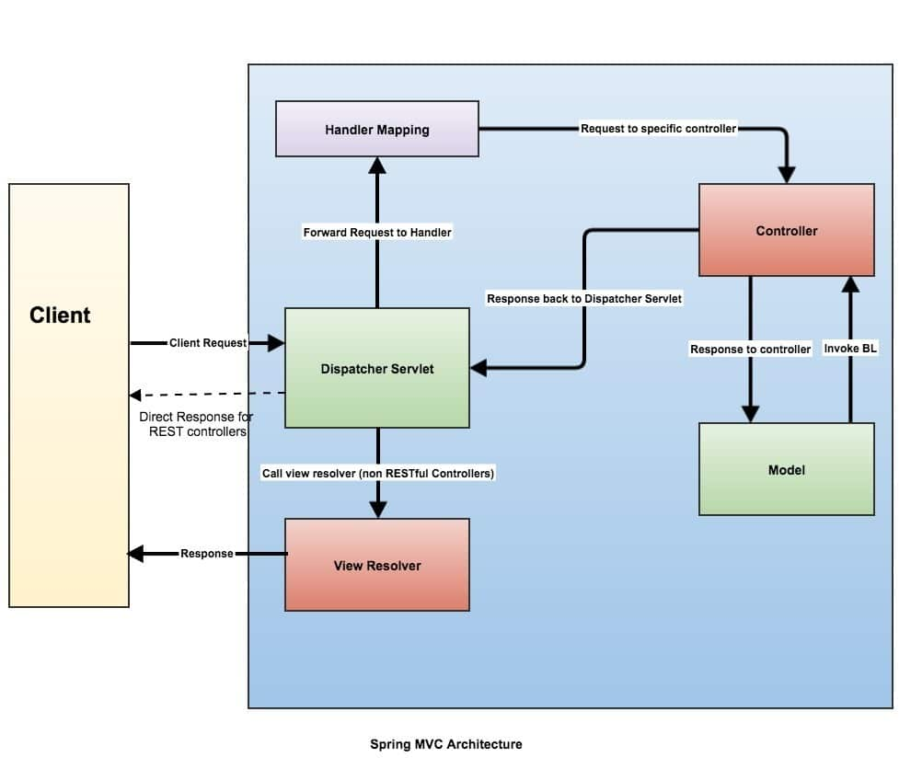
MVC

Slide 6
Spring beans - @RestController etc
@Scope
@ComponentScan(basePackages = “”)
Notes:
Ex 3 - make Pizzas work

Slide 7
Architecture?
Modules
Dependencies
Build
Notes:
First example - new Java project with maven + Tomcat + DispatcherServlet -> GET method

Slide 8
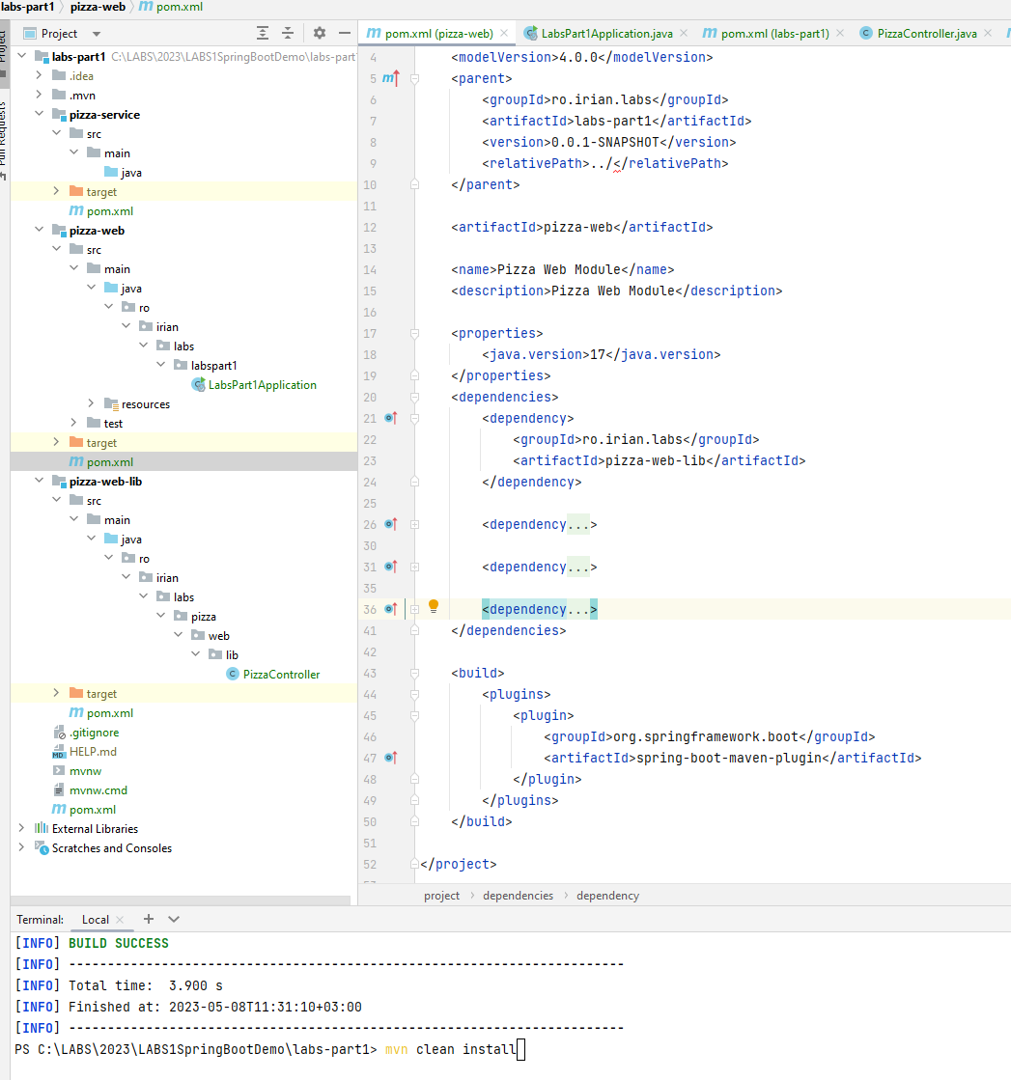
Notes:
Ex 1 - presentation Spring w/o Spring Boot

Slide 9

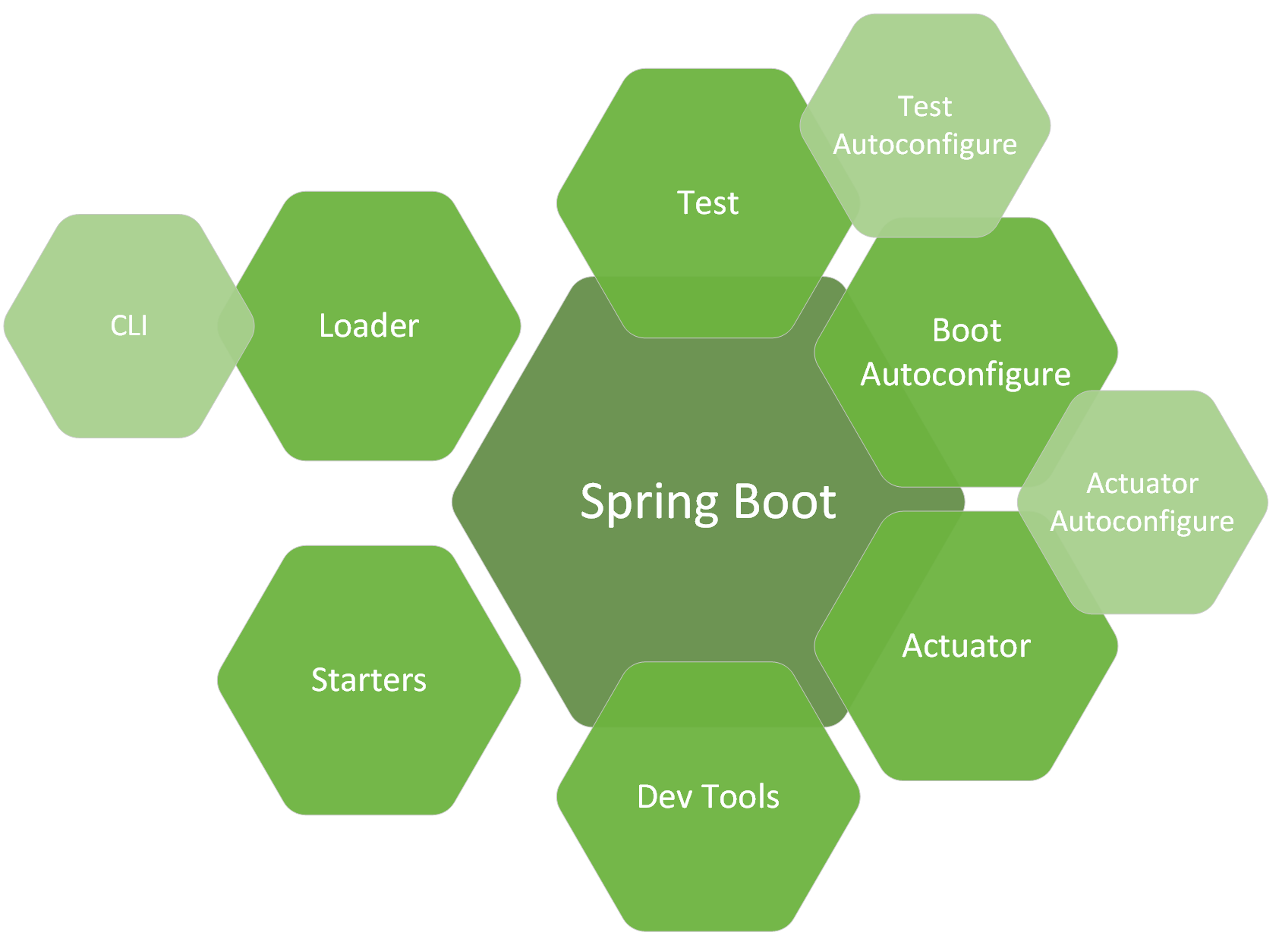
Spring Boot

Slide 10
spring-boot-starter-actuator
localhost:8080/actuator/health

Slide 11
spring-boot-starter-web
@RestController
@RequestMapping
@GetMapping
@PathVariable
@RequestParam
Notes:
Ex 1 - start a spring boot application + custom controller

Slide 12
Make some pizza
Dependency Injection
@Autowired
Constructor injection
Notes:
Ex 3 - Create Pizza Service, inject into Pizza Controller

Slide 13
Different pizza providers?
Collect into controller all pizzas from different services (ItalianPizzaService, AmericanPizzaService)
Notes:
Ex 3 - Create Pizza Service, inject into Pizza Controller

Slide 14

Layered architecture

Slide 15
